Slide 1
Static Analysis
Analysis without actually executing programs

Slide 2
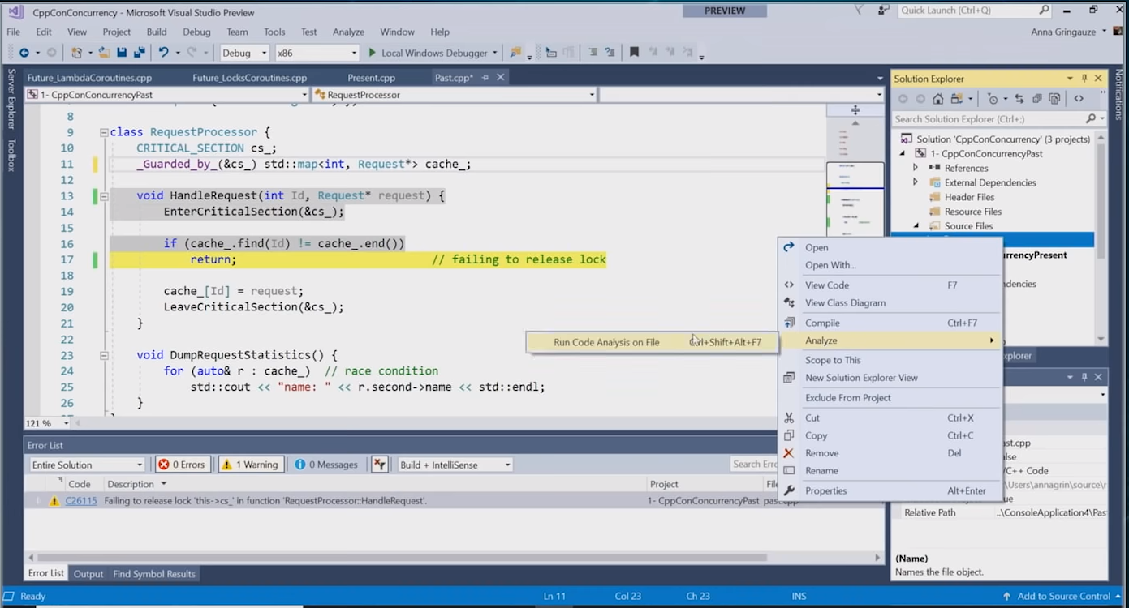

Slide 3
C needs annotation, locking violation, data race
Windows locking API
EnterCriticalSection / LeaveCriticalSection …
Annotation
_Guarded_by_
_Acquires_lock_
_Releases_lock_
….

Slide 4
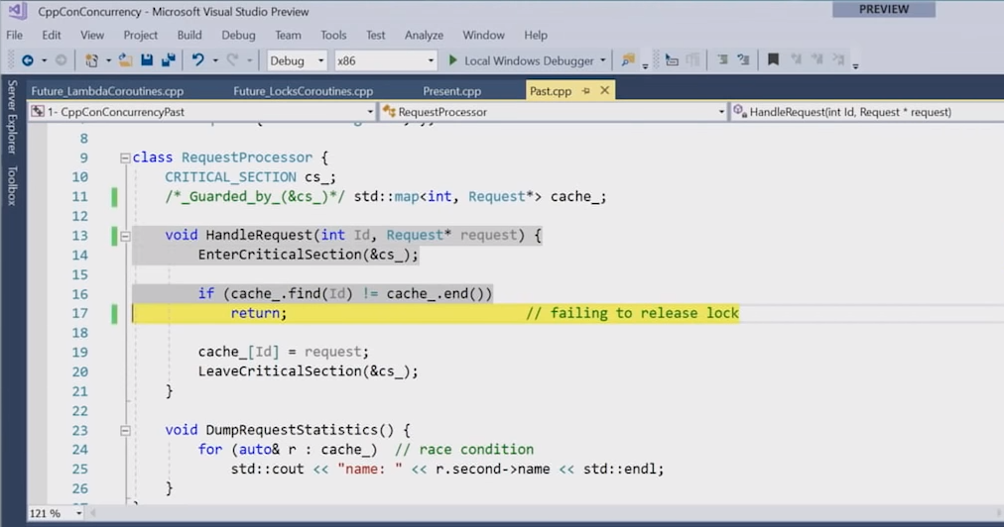

Slide 5
Now, C++ has lots of RAII types and locking APIs
Lock_guard
Mutex, timed_mutex, recursive_mutex
Lock(), try_lock() / unlock()
….

Slide 6
Static Analysis is useful for these things

Slide 7
